Slide 1


SQL Saturday 864
South Florida, United Sates
June 8, 2019
Hiram Fleitas
Fleitas Arts
github.com/hfleitas/Pixies
Notes:
Image ref: https://talesofarcadia.fandom.com/wiki/Jim_Lake_Jr.

Slide 2
Hack / Protect SQL Server
Learn Both
Tabular Data Stream
Load Test
Dynamic Data Masking
Row-Level Security
Bonus
Hiram Fleitas
Fleitas Arts
github.com/hfleitas/Pixies
Notes:
Image ref: https://talesofarcadia.fandom.com/wiki/Jim_Lake_Jr.

Slide 3


Please silence cell phones

Slide 4
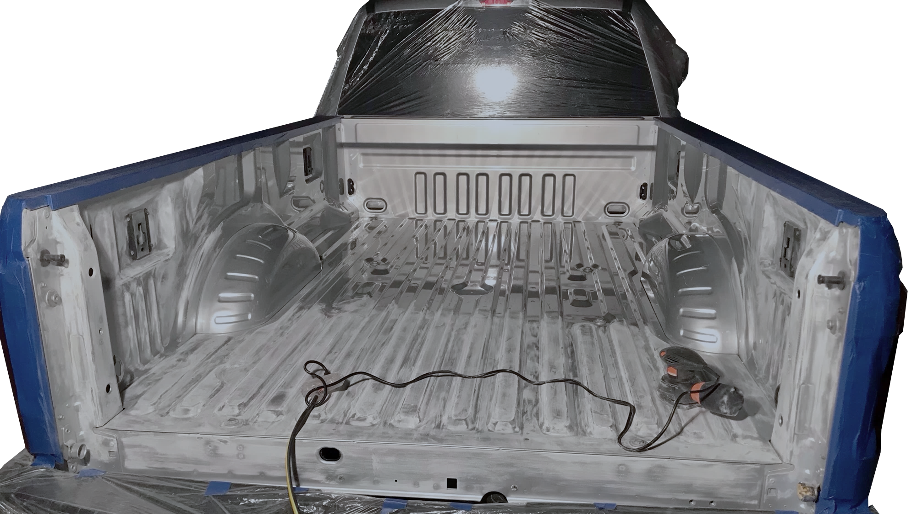

Slide 5
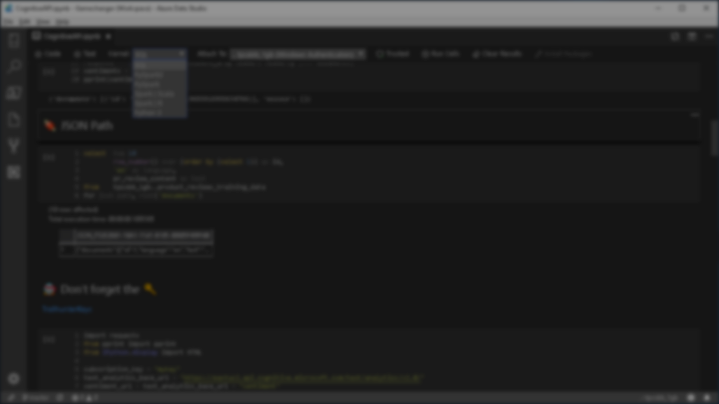



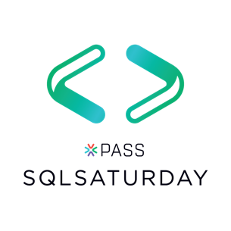



Explore everything PASS has to offer
Free online webinar events
Local user groups around the world
Free 1-day local training events
Free Online Resources
Newsletters
PASS.org
Online special interest user groups
Business analytics training
Get involved

Slide 6
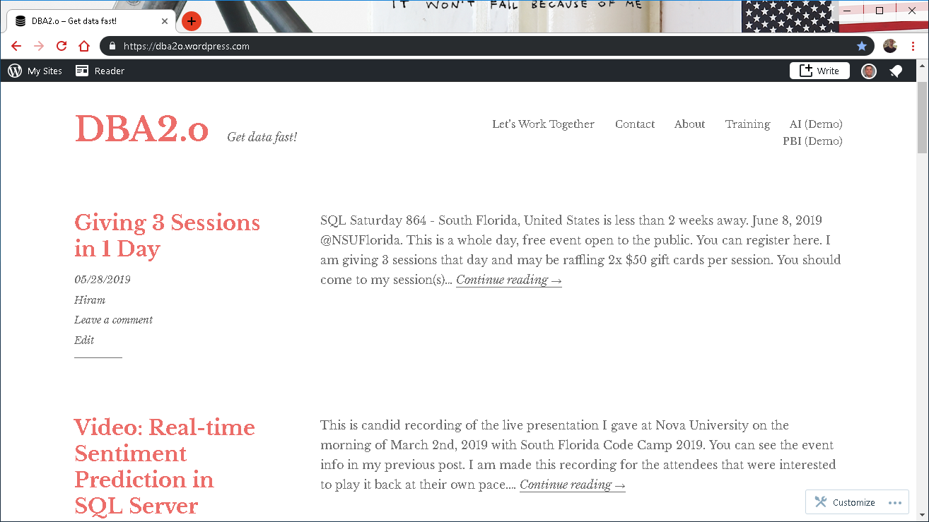

Slide 7

Session evaluations
This is the link:
bit.ly/pixies19
Your feedback is very important.
Submit your feedback by the end of this presentation.

Slide 8


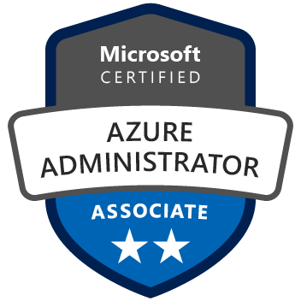
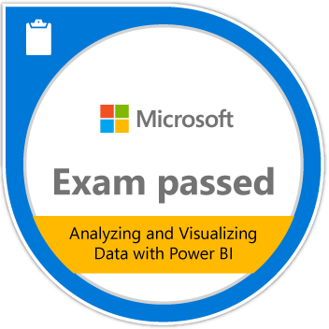







Hiram Fleitas
Owner Fleitas Arts
Bio
Father
Principal DB Architect
Power BI since 2016
Developer since 1995
SQL Server since 1999
USCG Auxiliary Flotilla Staff Officer
@hiramfleitas
/hfleitas
hiram@fleitasarts.com
hiramfletias
fleitasarts.com

Slide 9
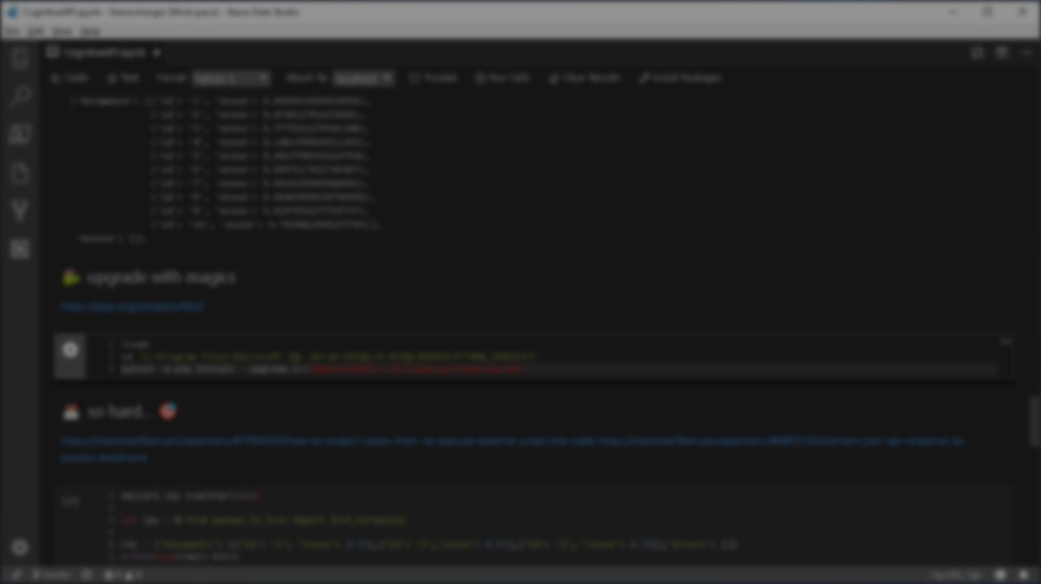

Agenda
Hack Tabular Data Stream (TDS)
Load Test Encryption
Hack Dynamic Data Masking (DDM)
Hack Row-Level Security (RLS)
DB Source Control (TFS/Git)
Machine Learning & AI
Resources

Slide 10

DEMO 1
TDS Encryption

Slide 11
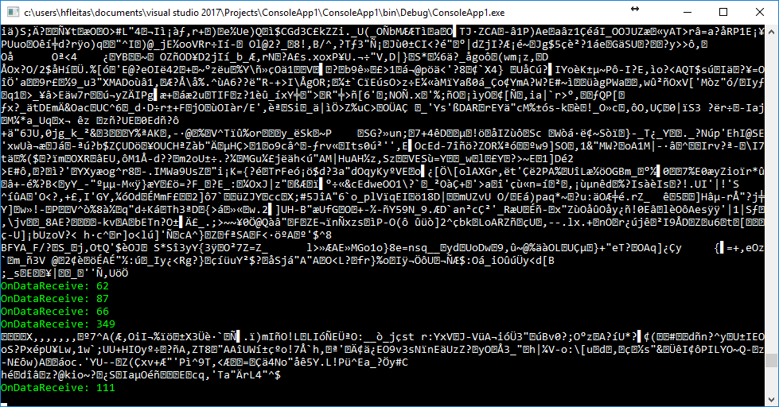
Force Encryption

Slide 12
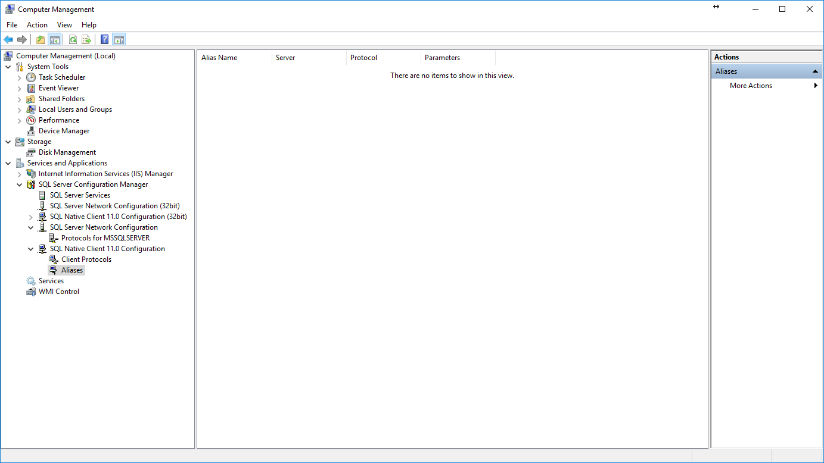
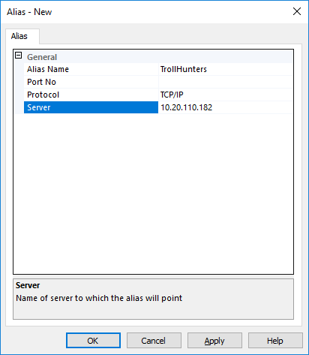
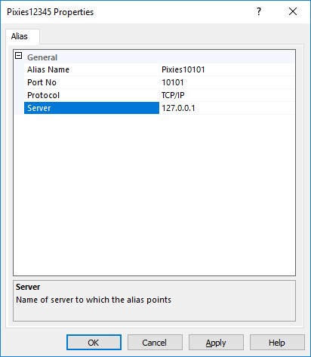
Notes:
Trollhunters MTM: (requirements: ssms, sql2008+, remote svr, vs2017 community, wireshark)
*port number is required in alias name for the hack by TcpForwarderSlim.

Slide 13
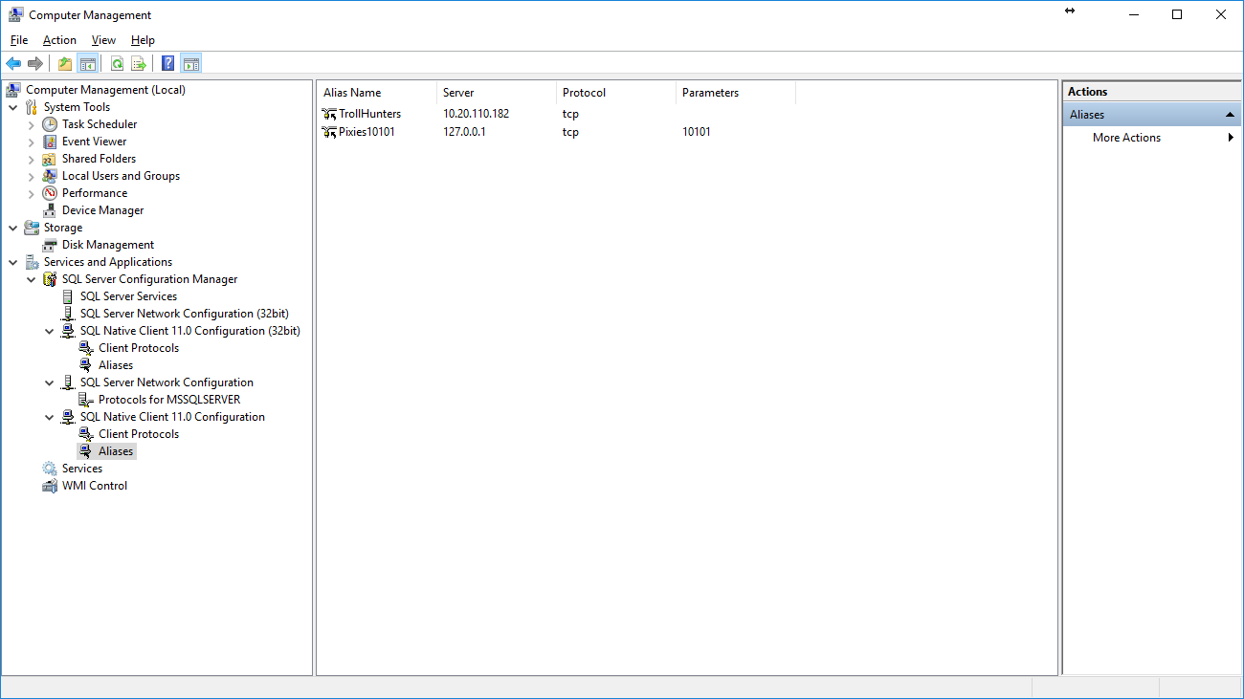

Slide 14
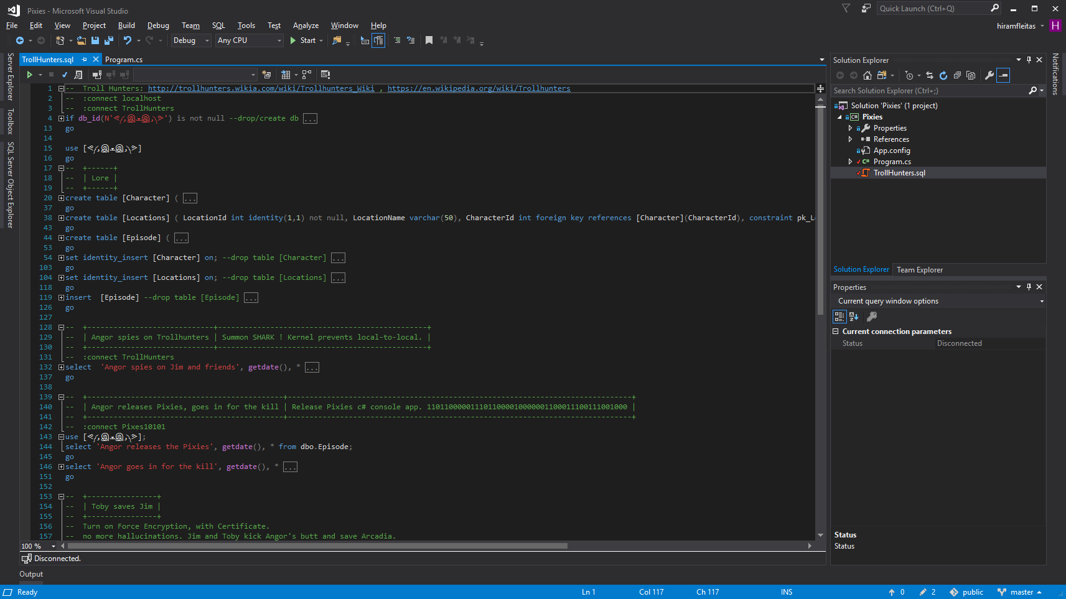

Slide 15
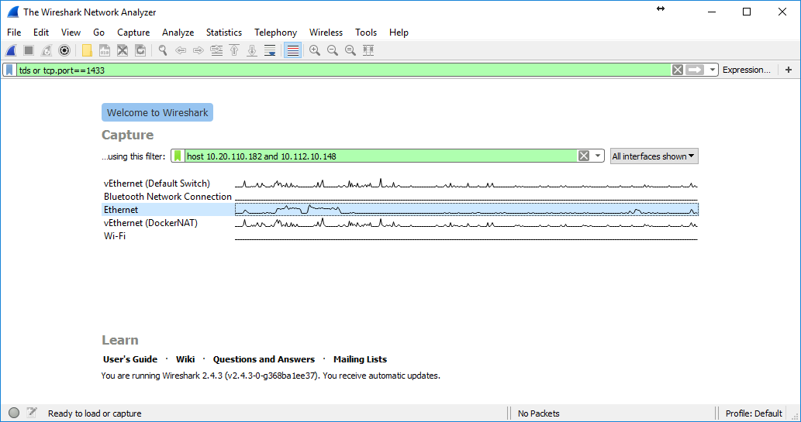

Slide 16
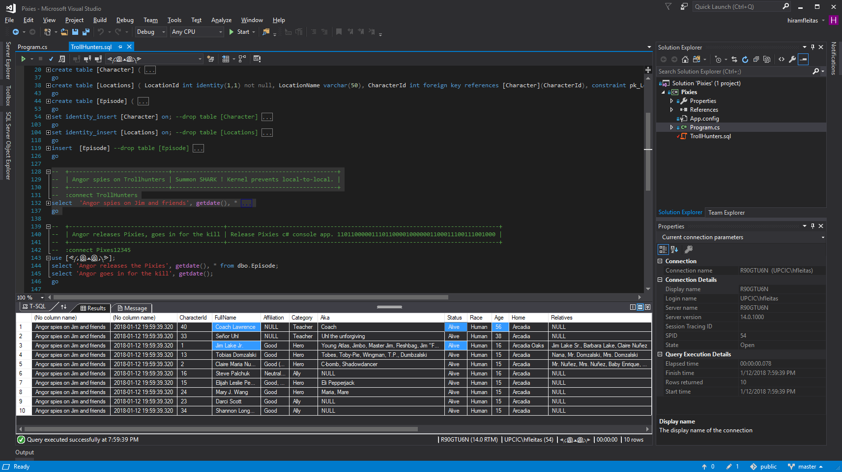
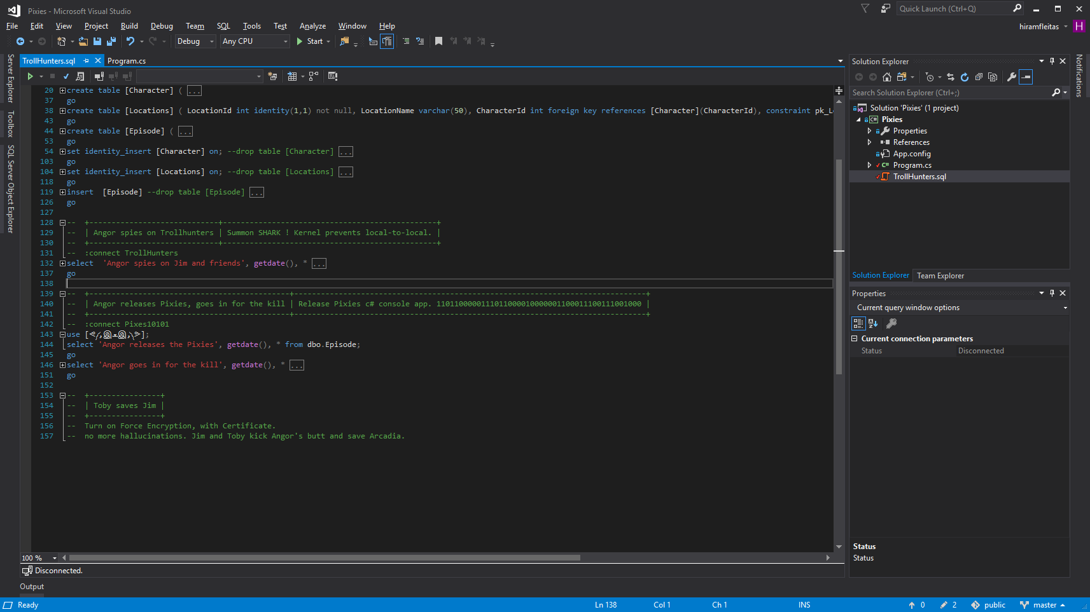

Slide 17
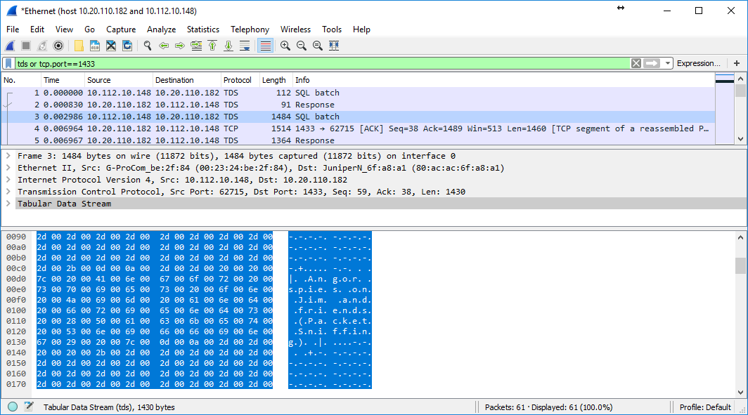

Slide 18
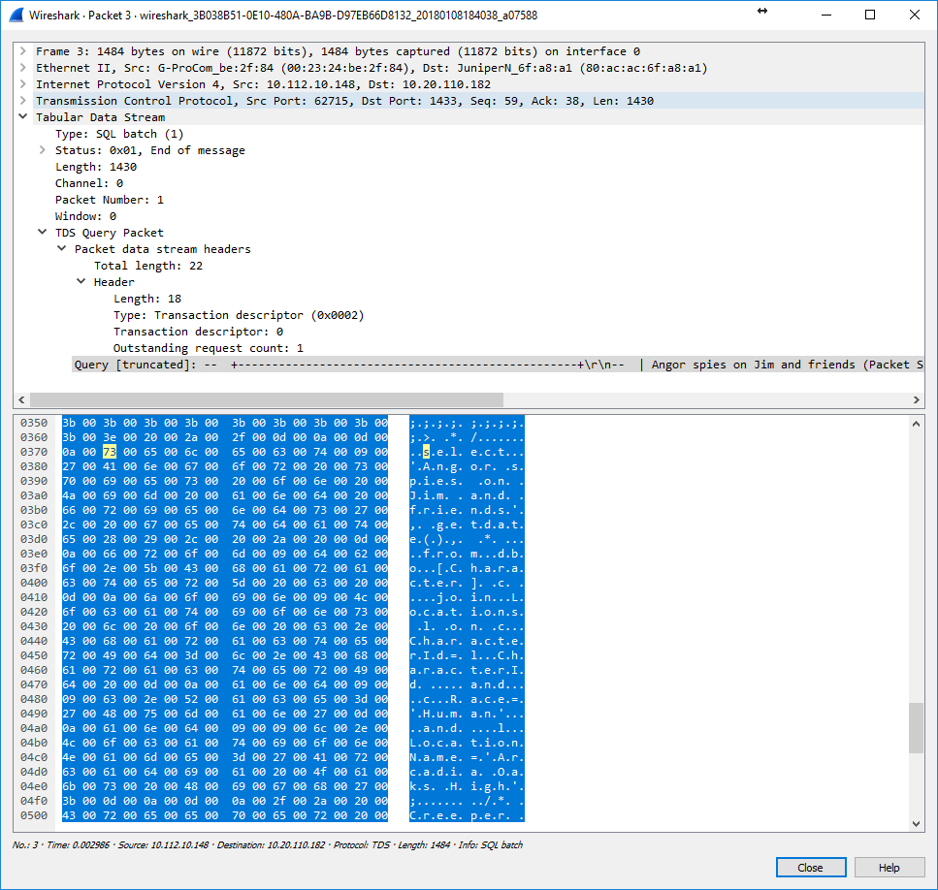

Slide 19
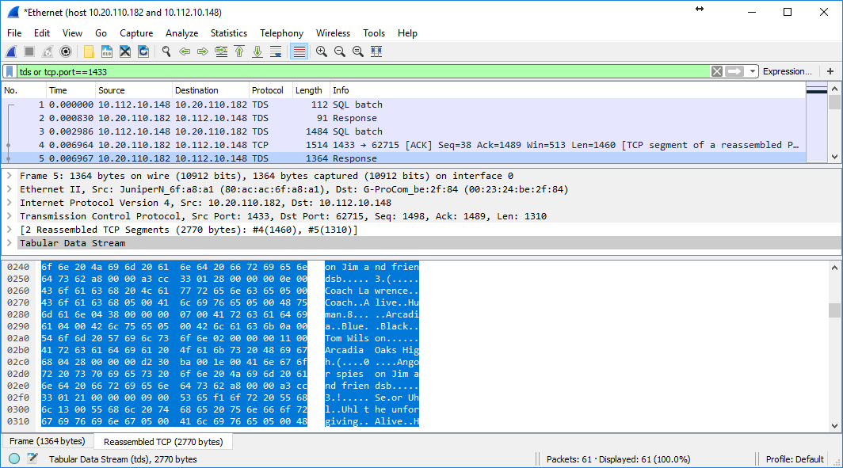

Slide 20
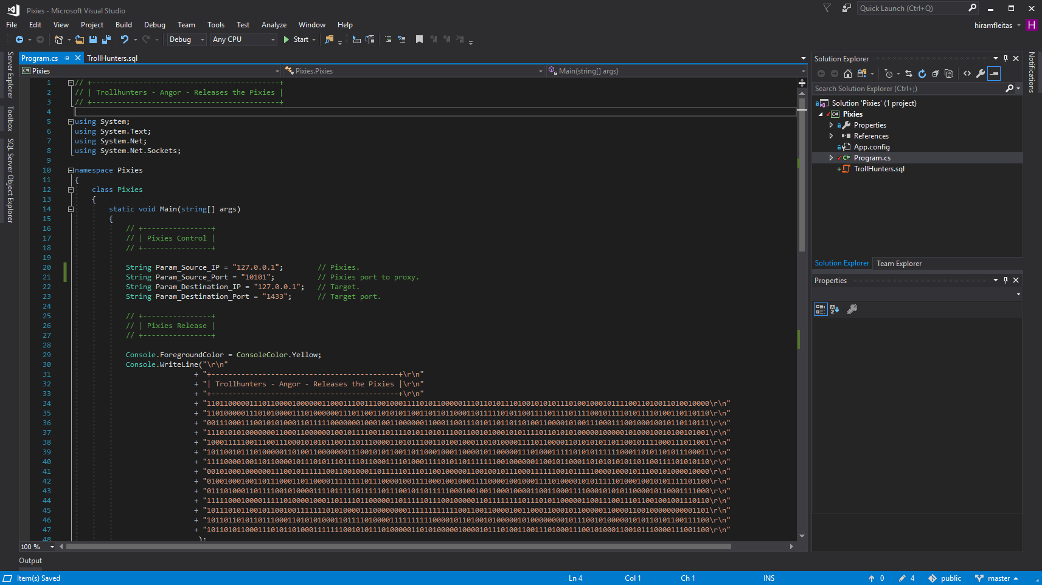

Slide 21
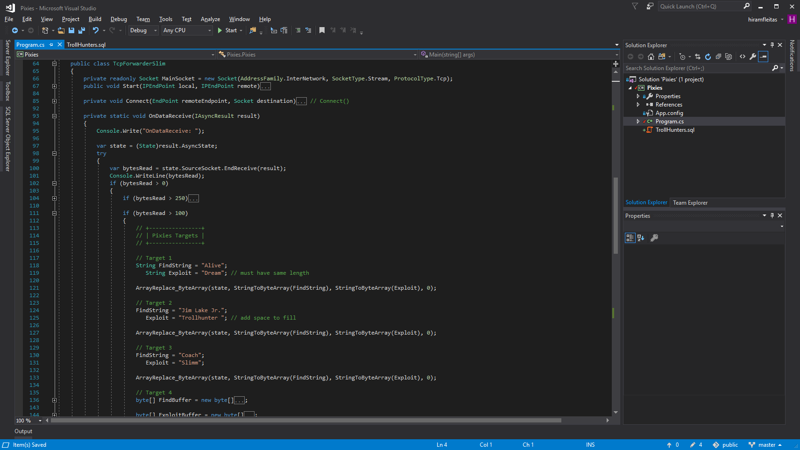

Slide 22
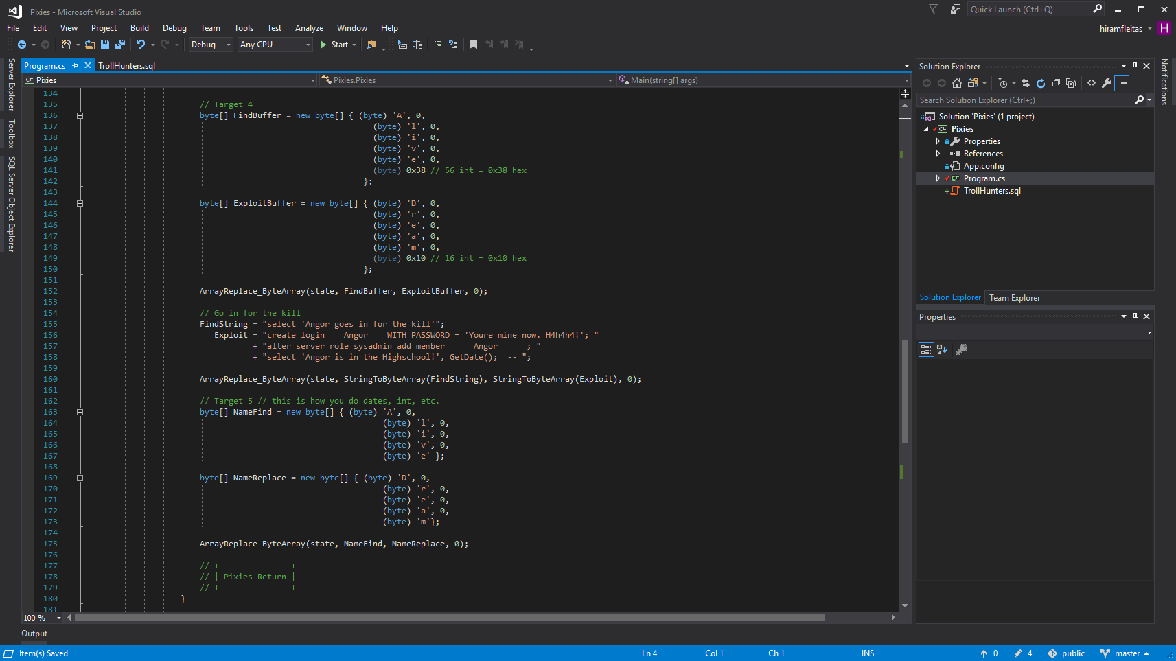

Slide 23
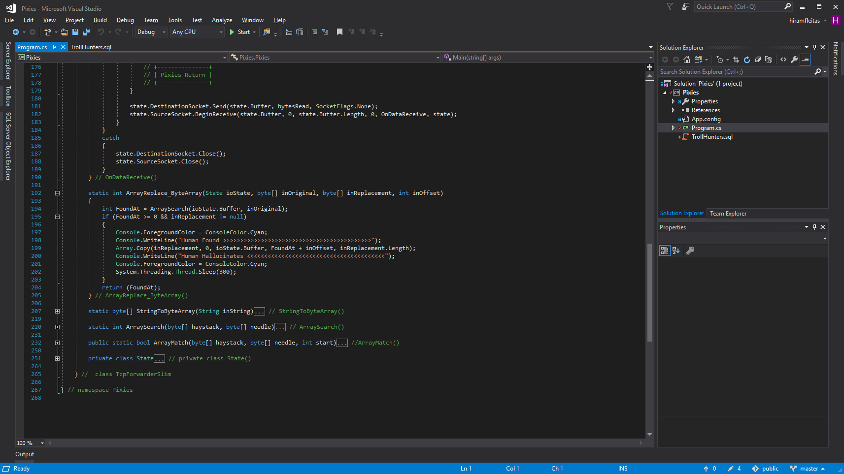

Slide 24
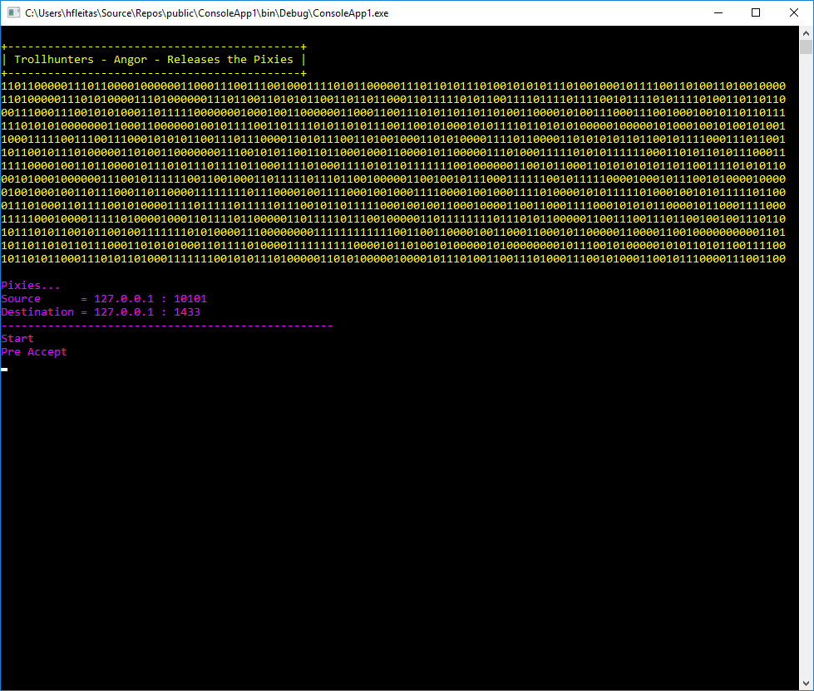

Slide 25
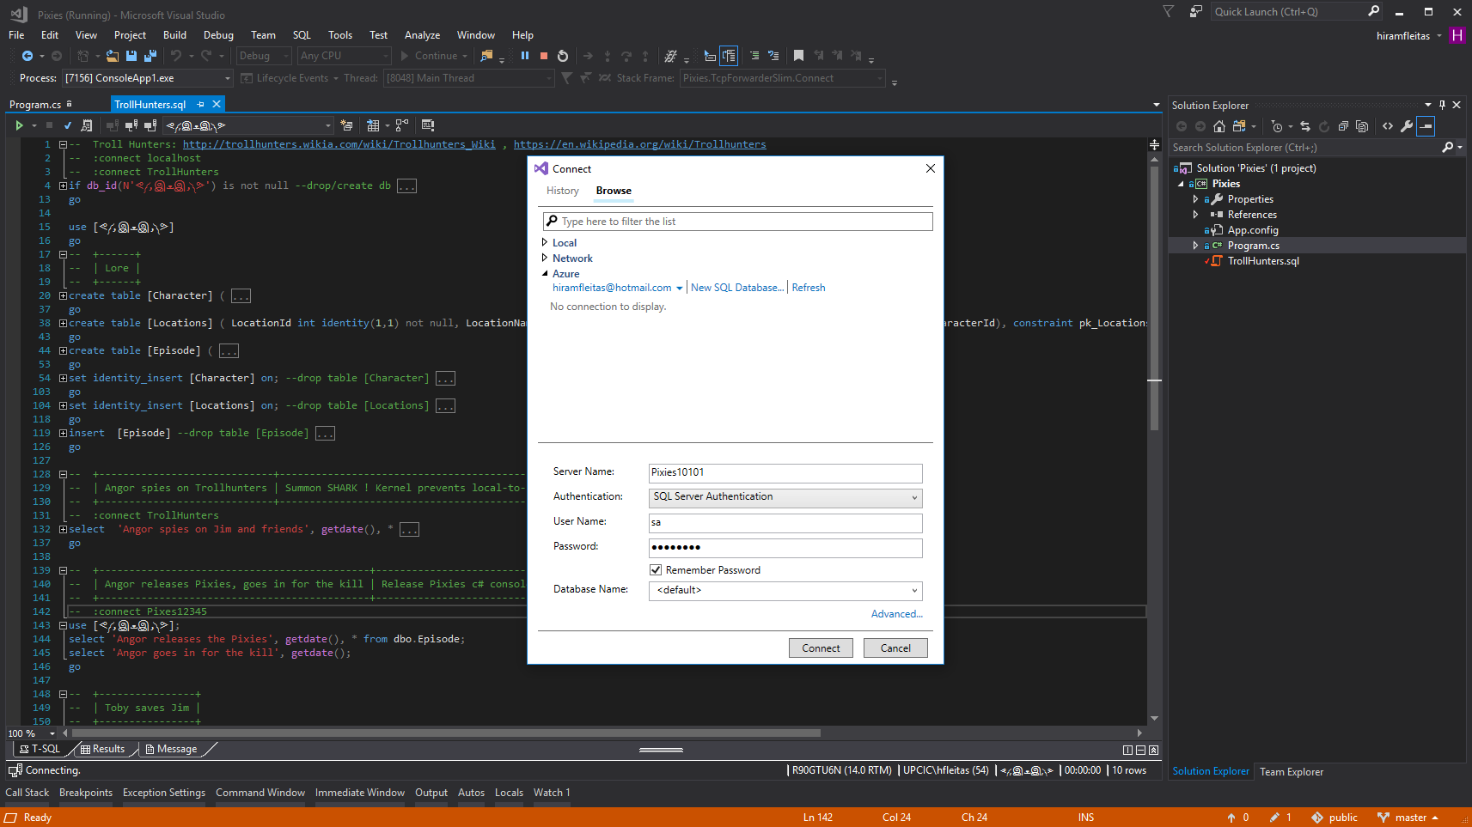
Notes:
TURN OFF INTELLISENSE before connecting.

Slide 26
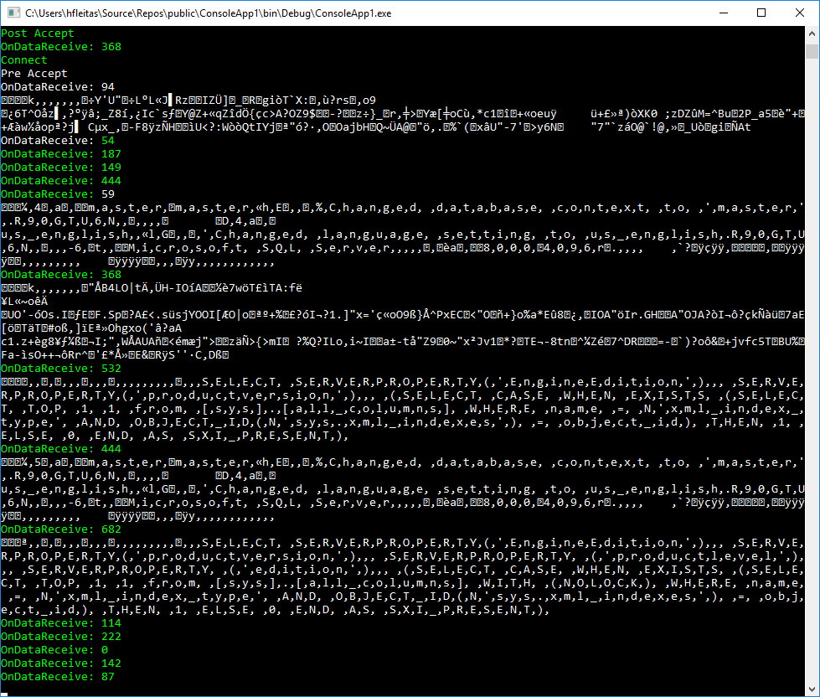

Slide 27
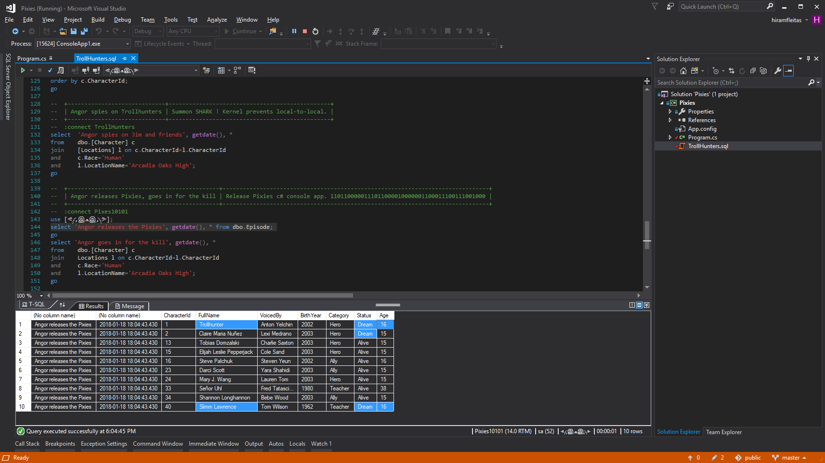

Slide 28
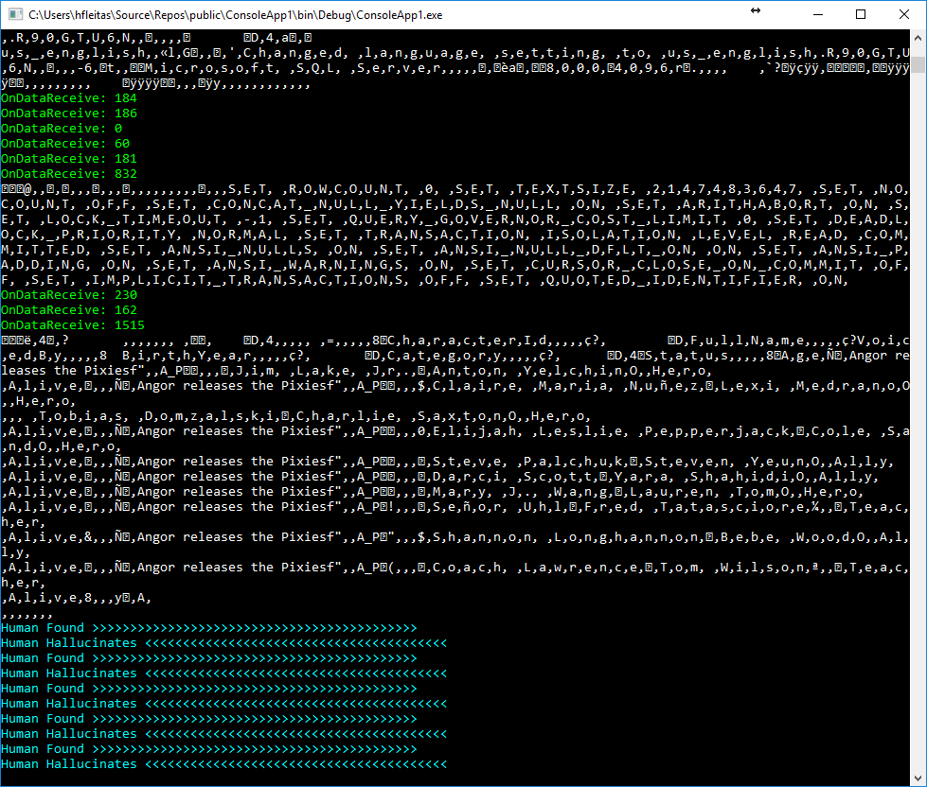

Slide 29
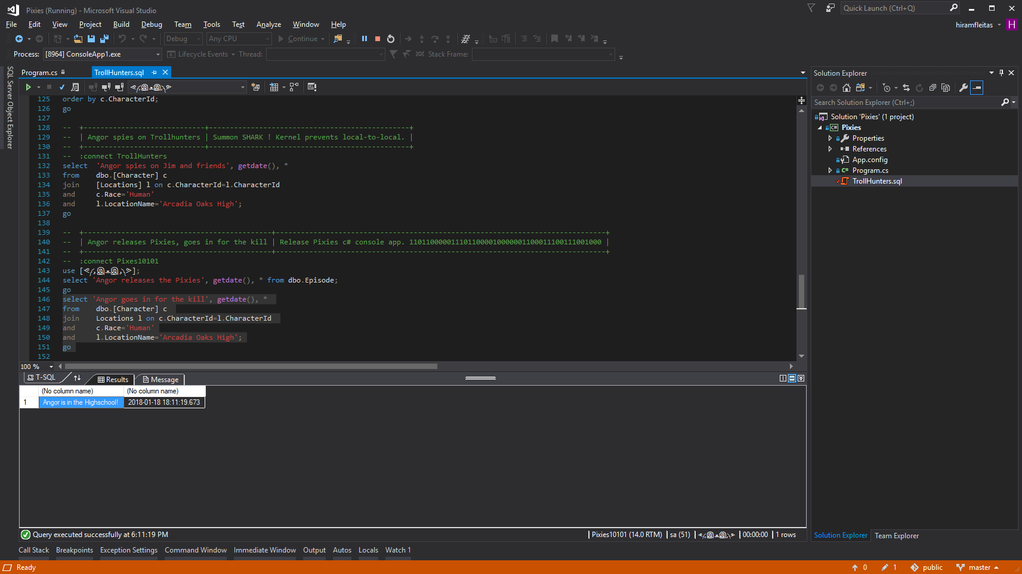

Slide 30
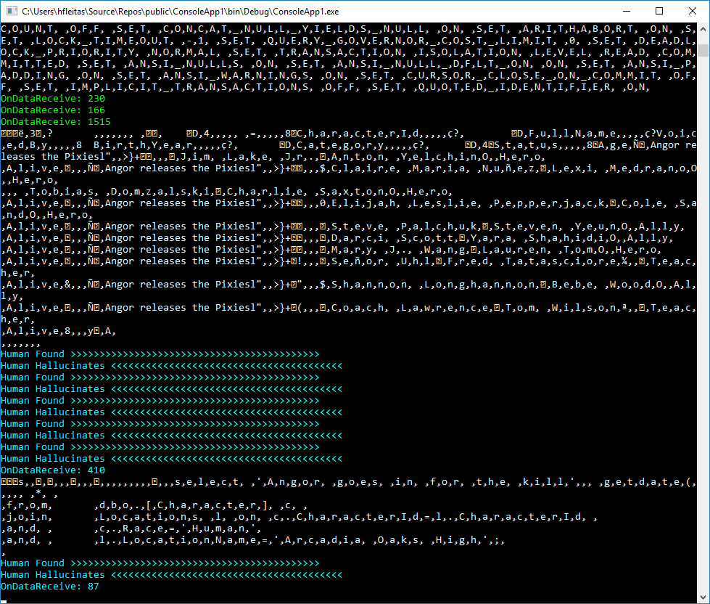

Slide 31
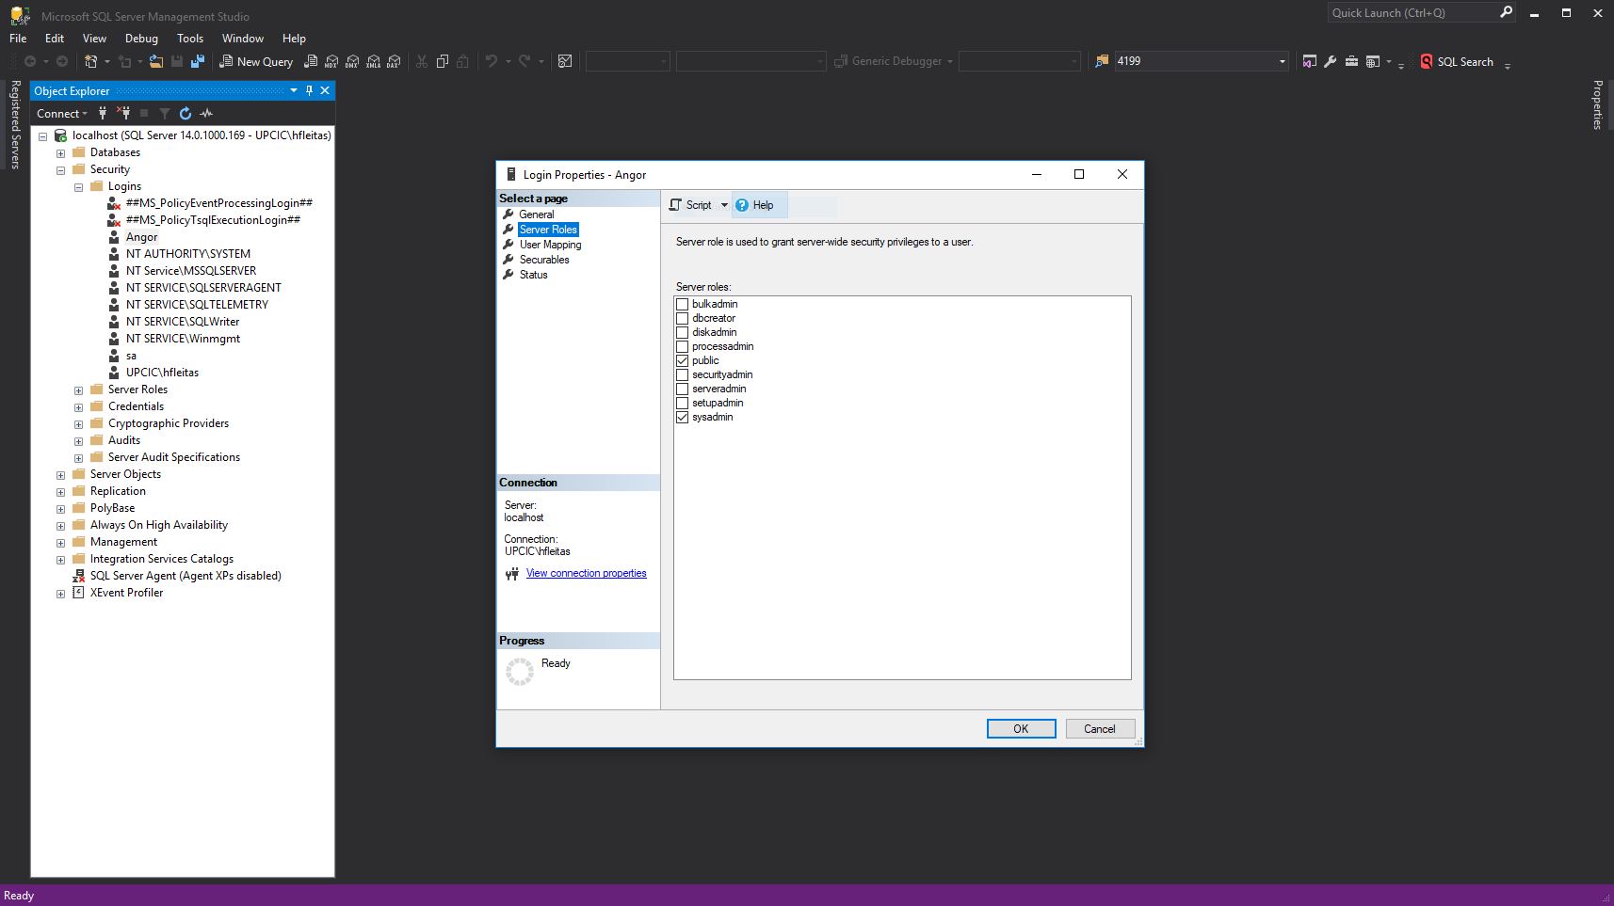

Slide 32
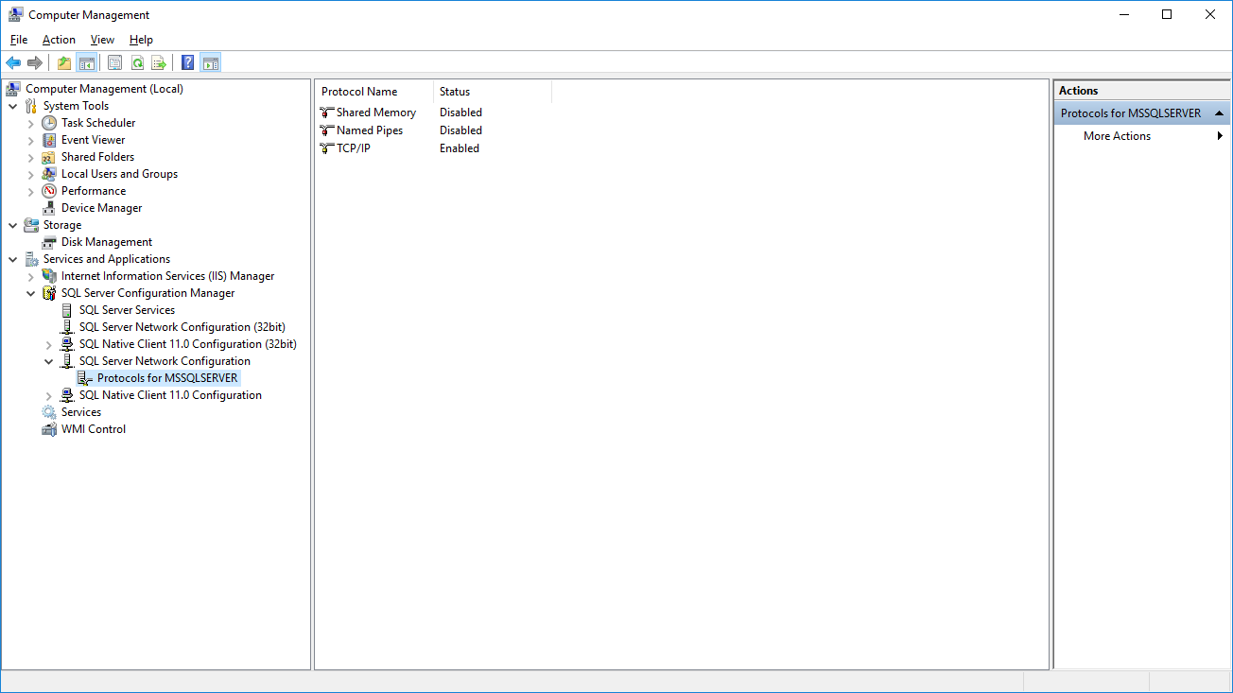
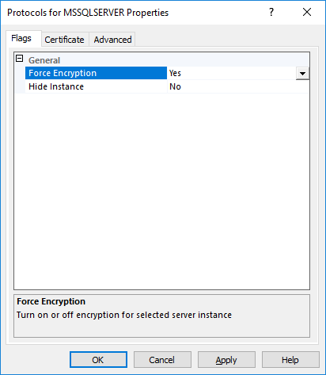
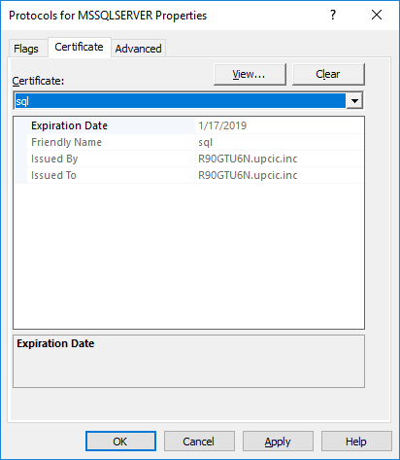
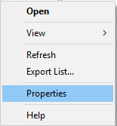
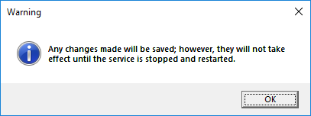
Notes:
Ref: https://docs.microsoft.com/en-us/sql/database-engine/configure-windows/enable-encrypted-connections-to-the-database-engine
Note:
To use encryption with a failover cluster, you must install the server certificate with the fully qualified DNS name of the virtual server on all nodes in the failover cluster. For example, if you have a two-node cluster, with nodes named test1.<your company>.com and test2.<your company>.com, and you have a virtual server named virtsql, you need to install a certificate for virtsql.<your company>.com on both nodes. You can set the value of the ForceEncryptionoption to Yes.

Slide 33
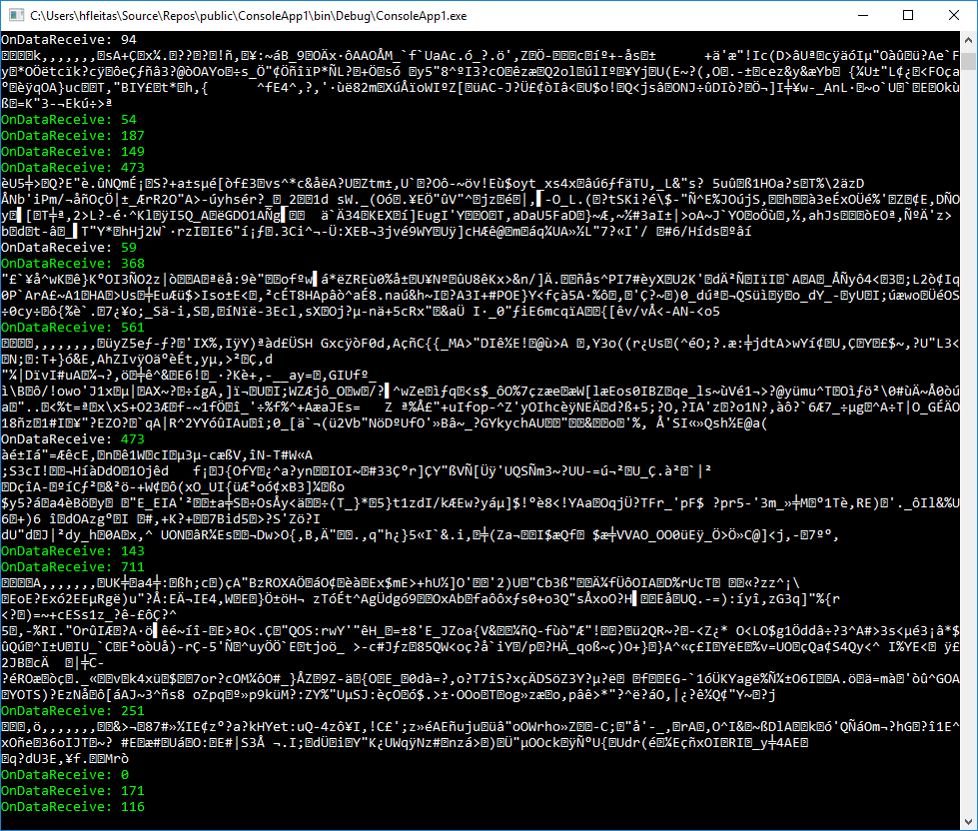

Slide 34
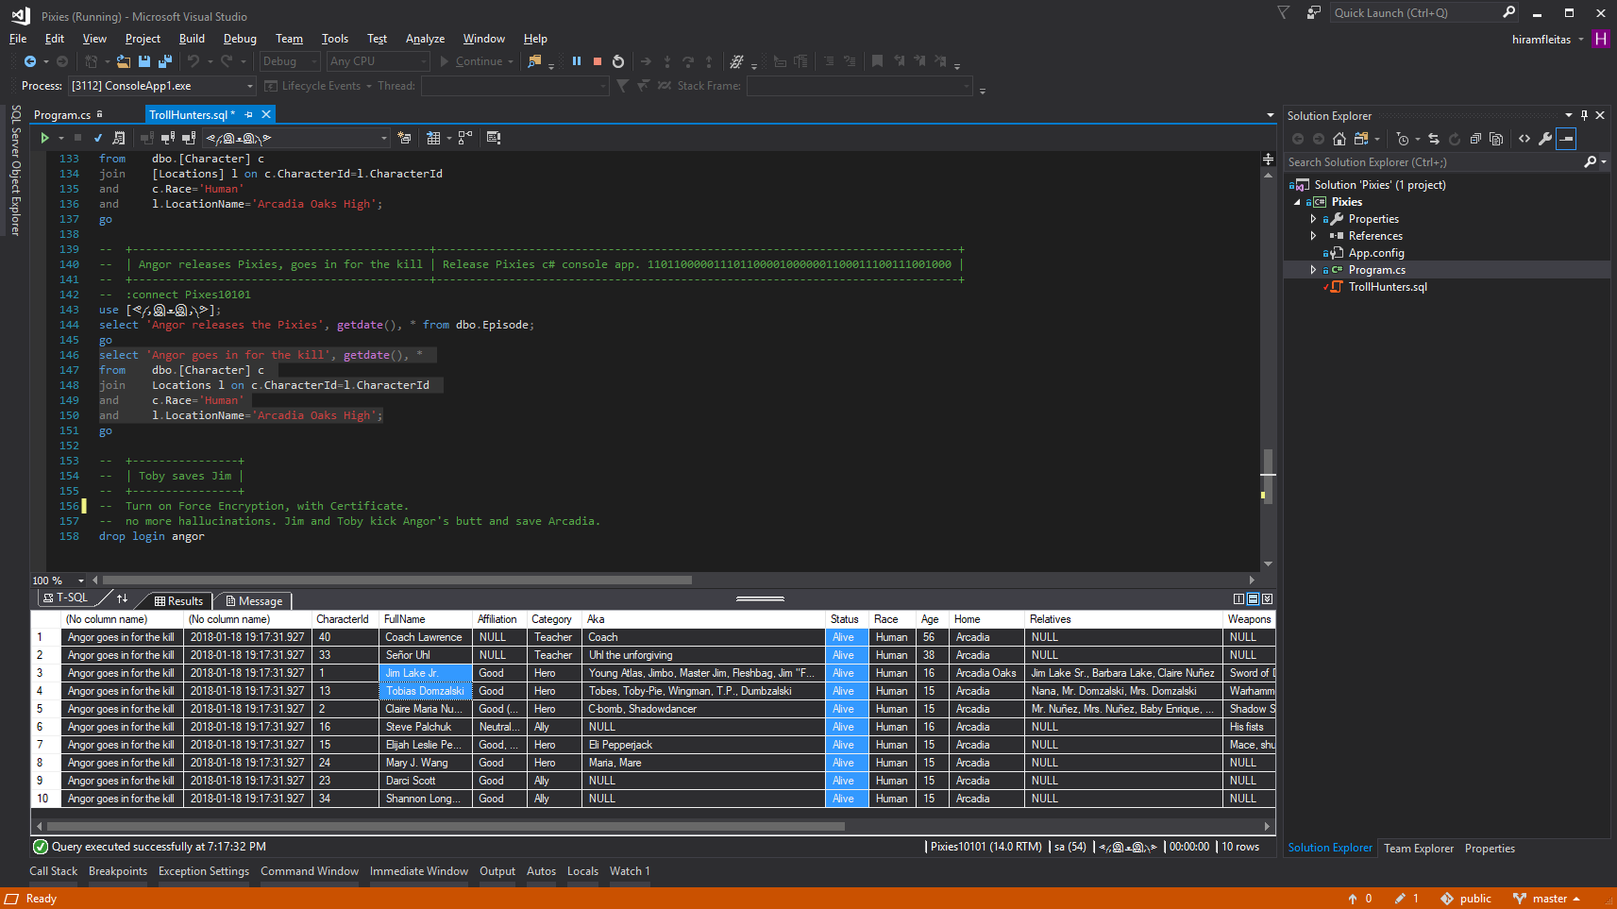

Slide 35
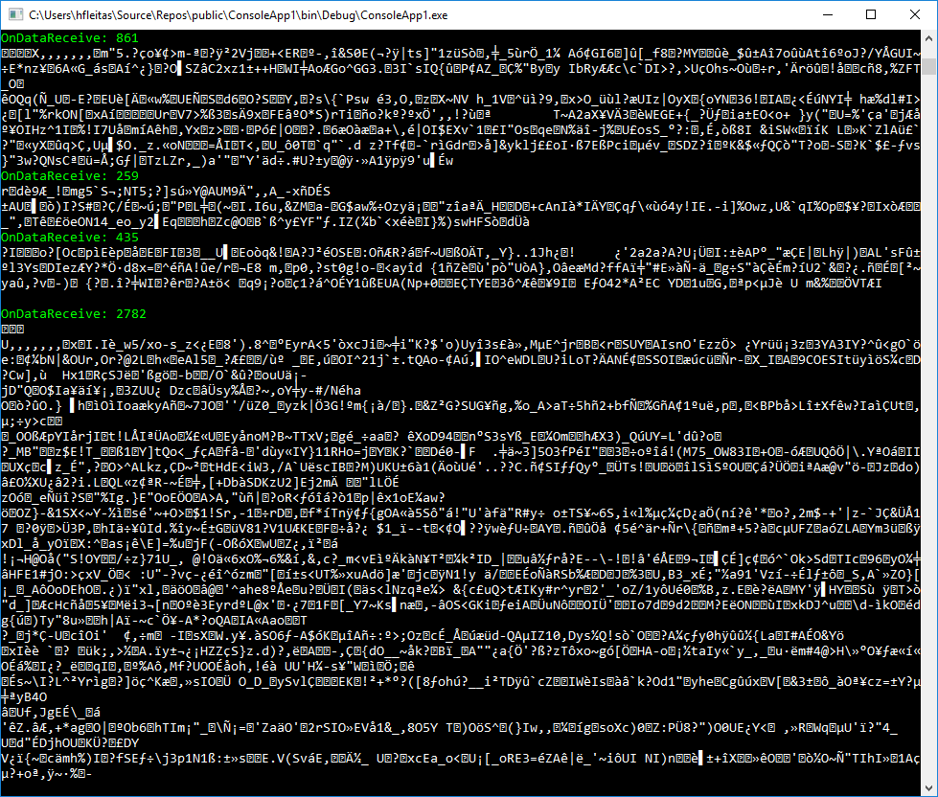

Slide 36
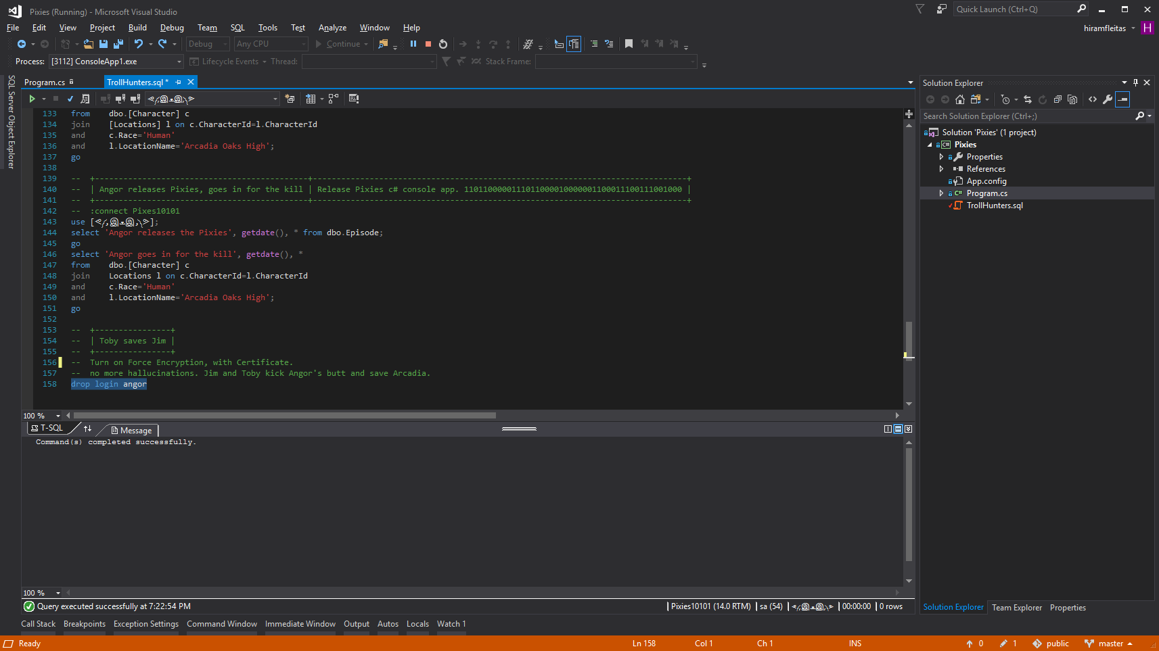

Slide 37
DEMO 2
Load Test

Slide 38
Load Test Comparison

Slide 39
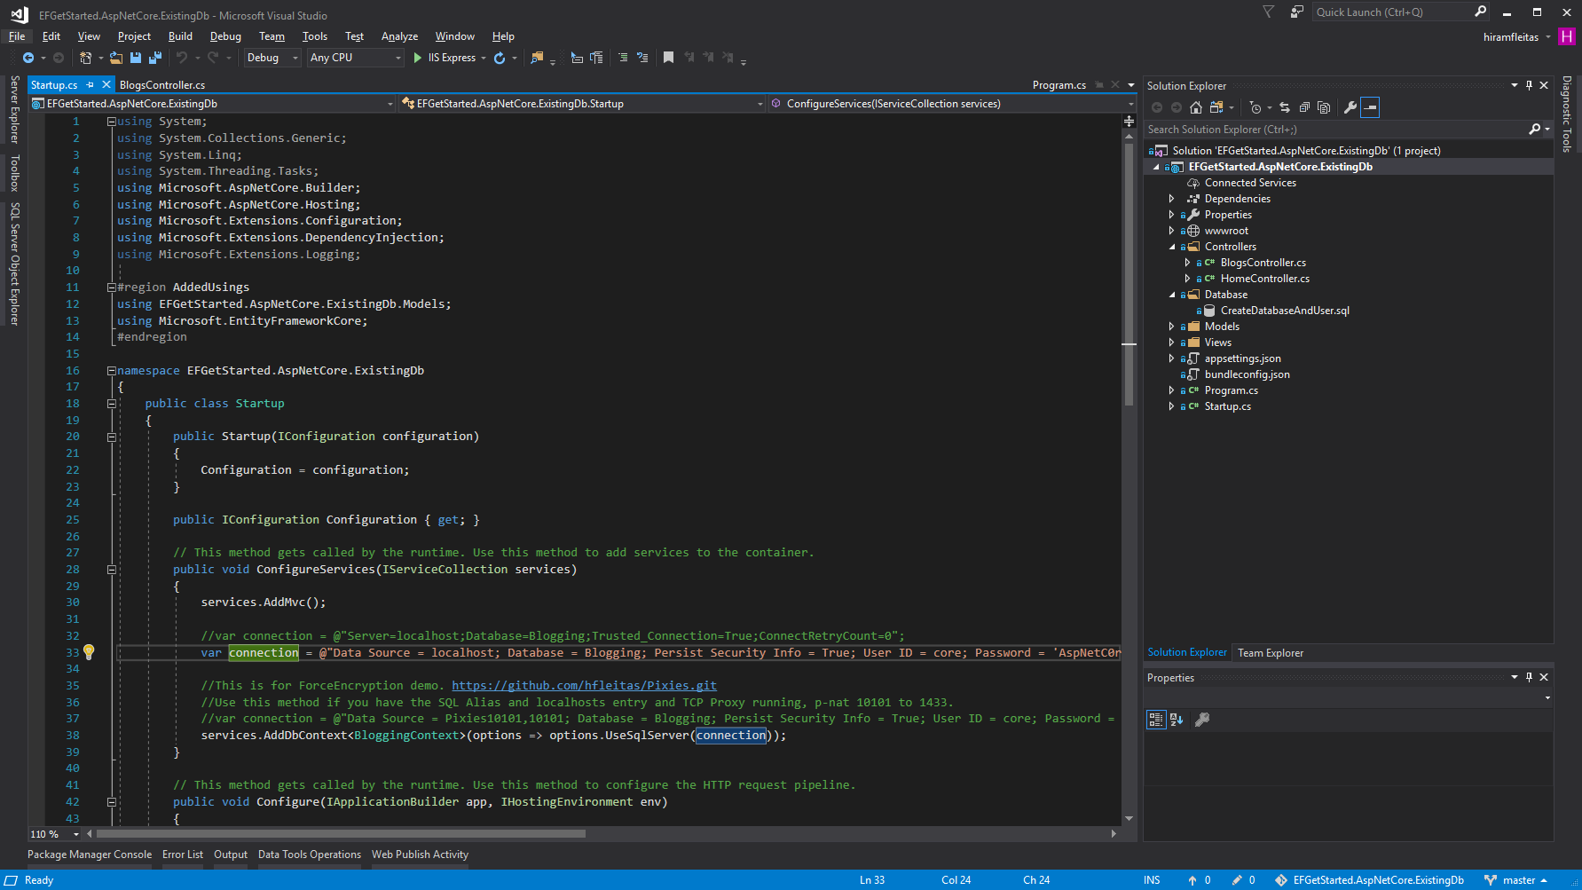
Notes:
https://github.com/hfleitas/EFGetStarted.AspNetCore.ExistingDb

Slide 40
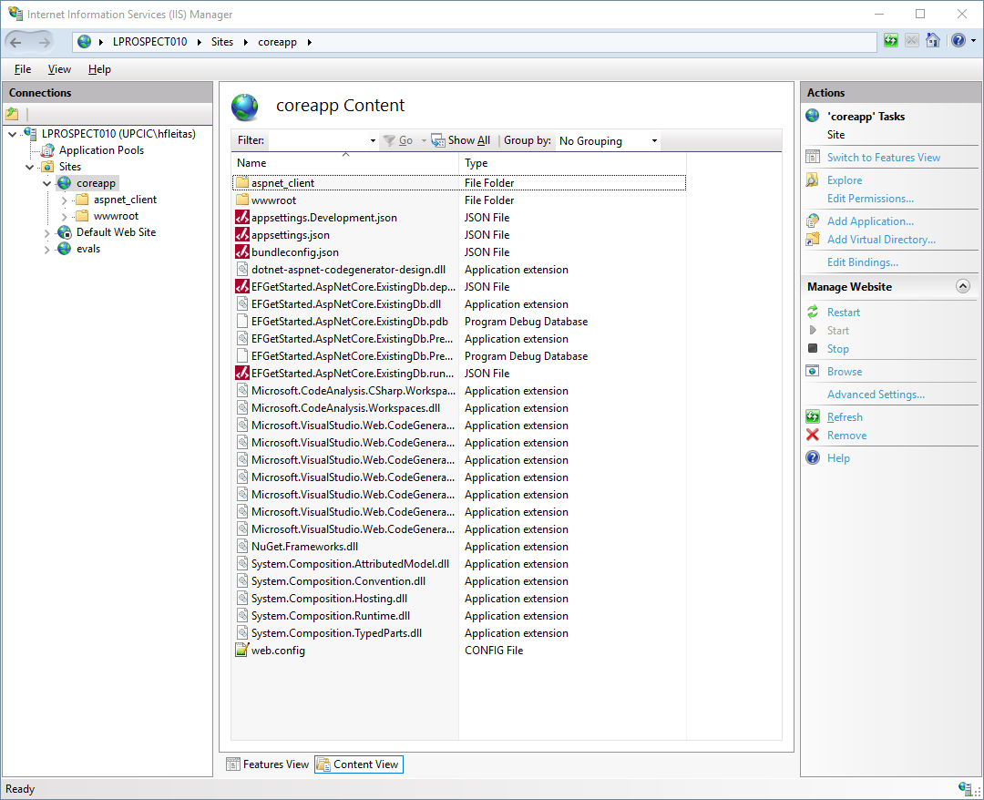

Slide 41
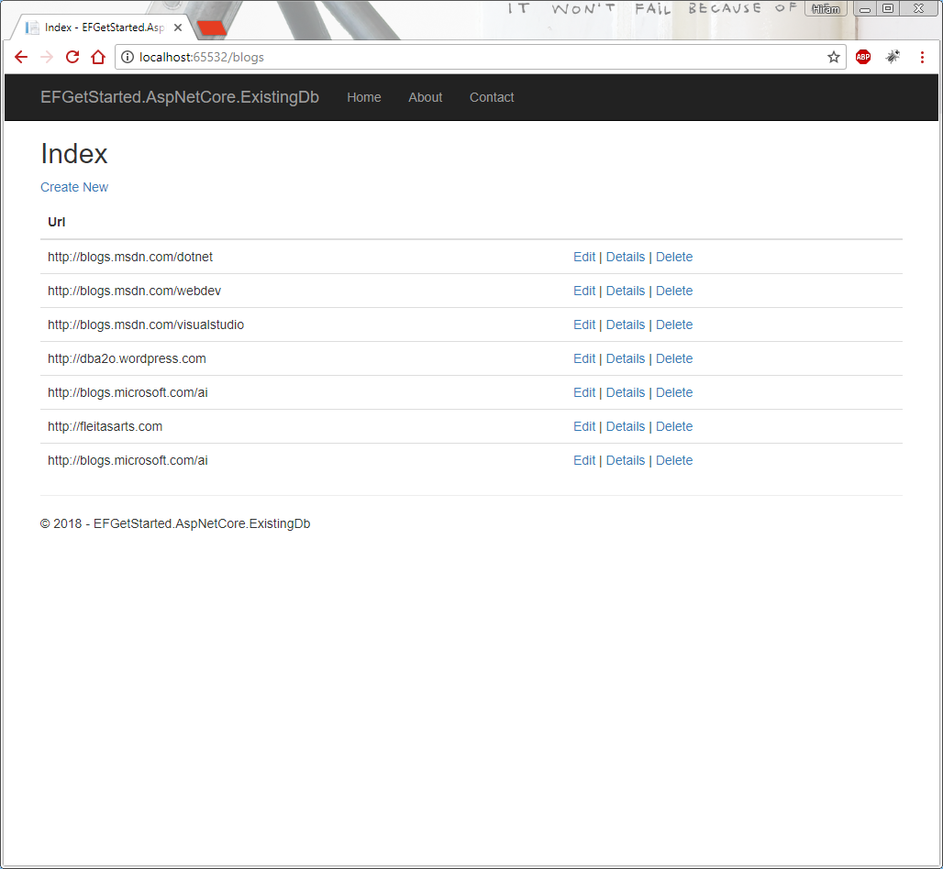

Slide 42
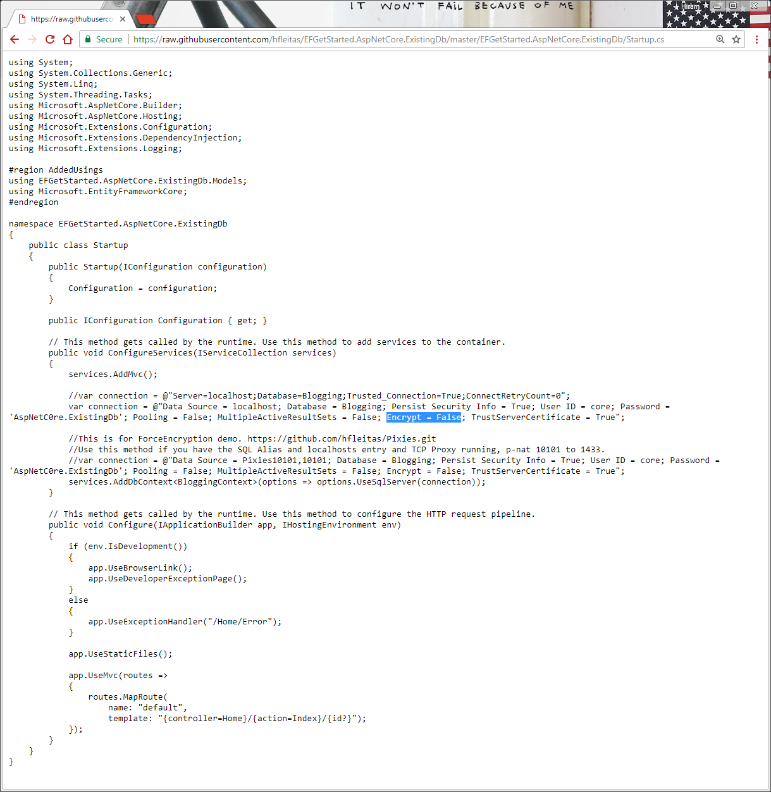

Slide 43
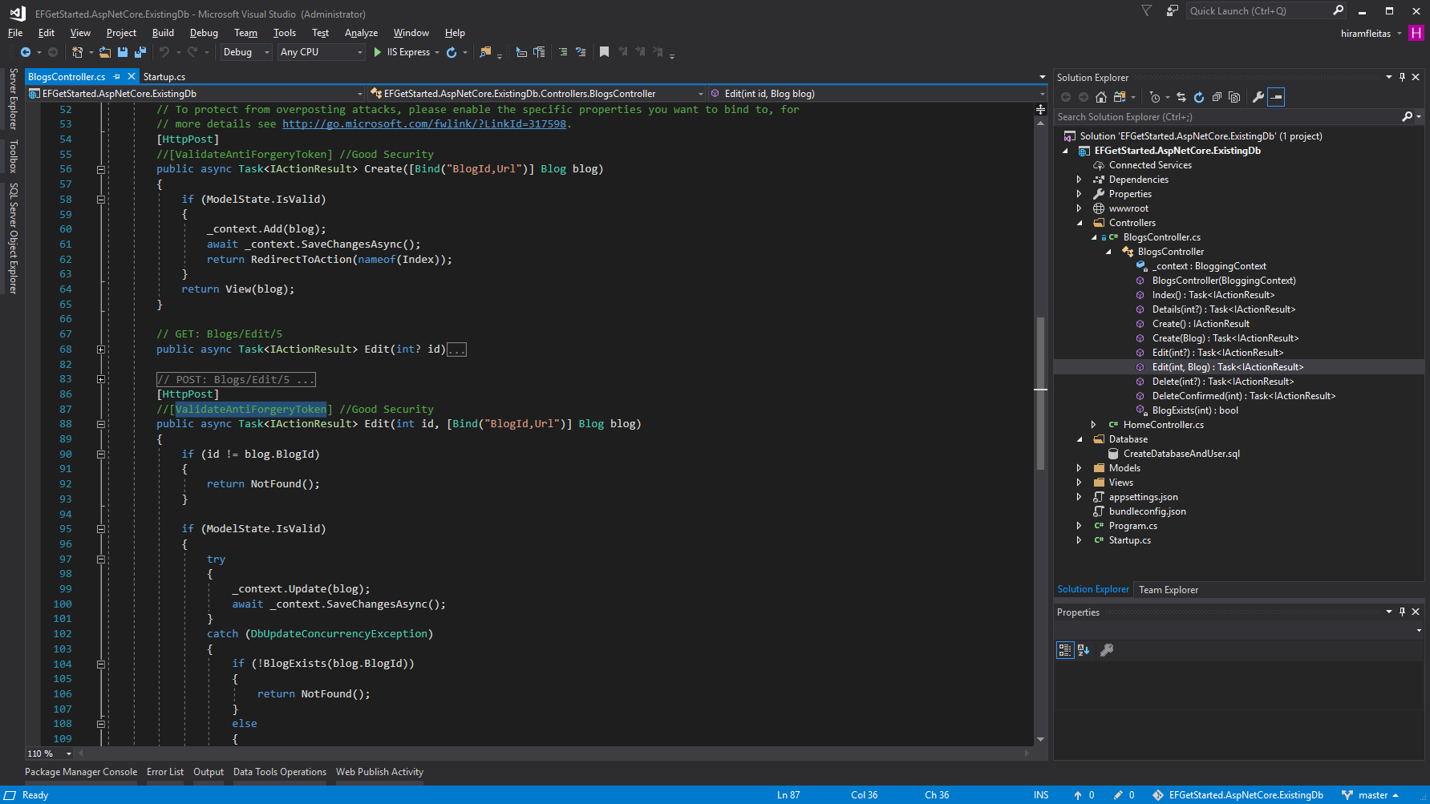

Slide 44
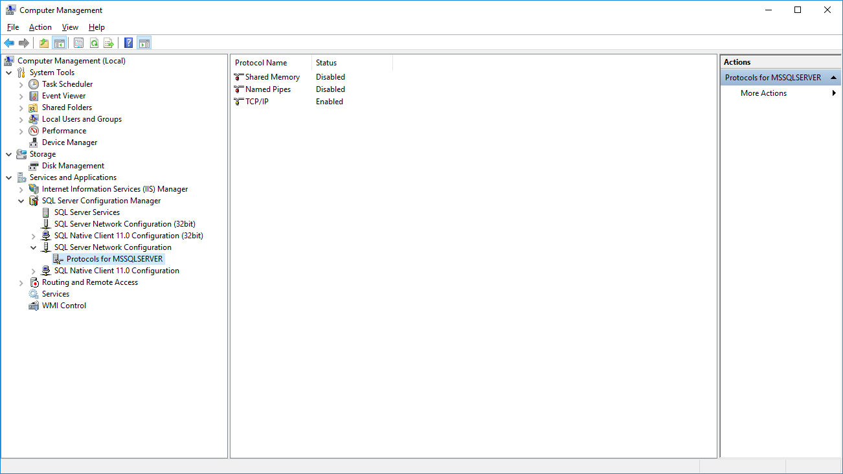

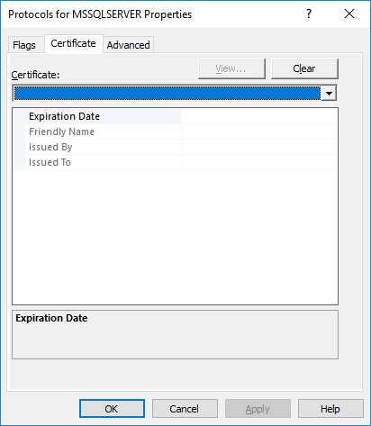

Slide 45
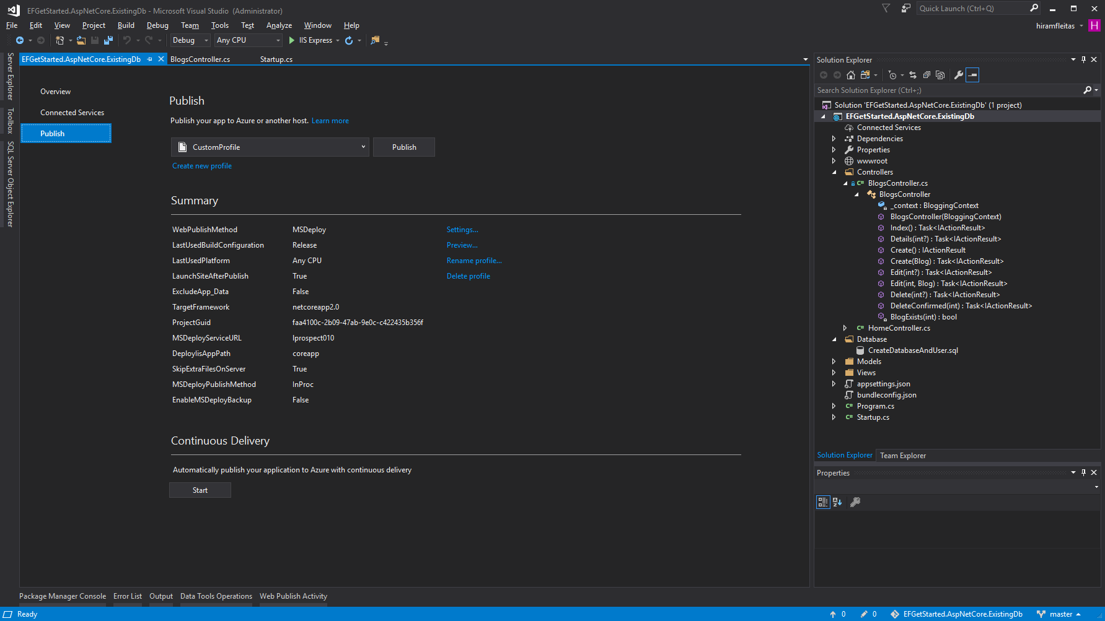

Slide 46
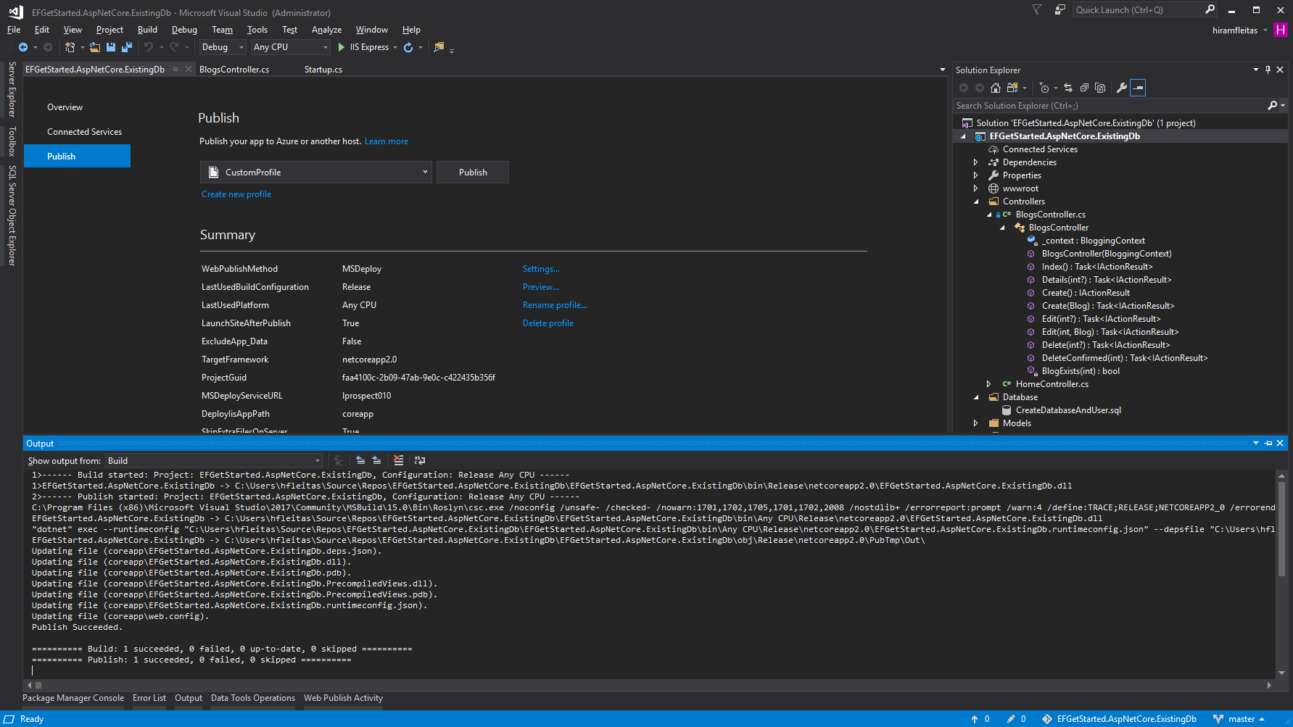

Slide 47
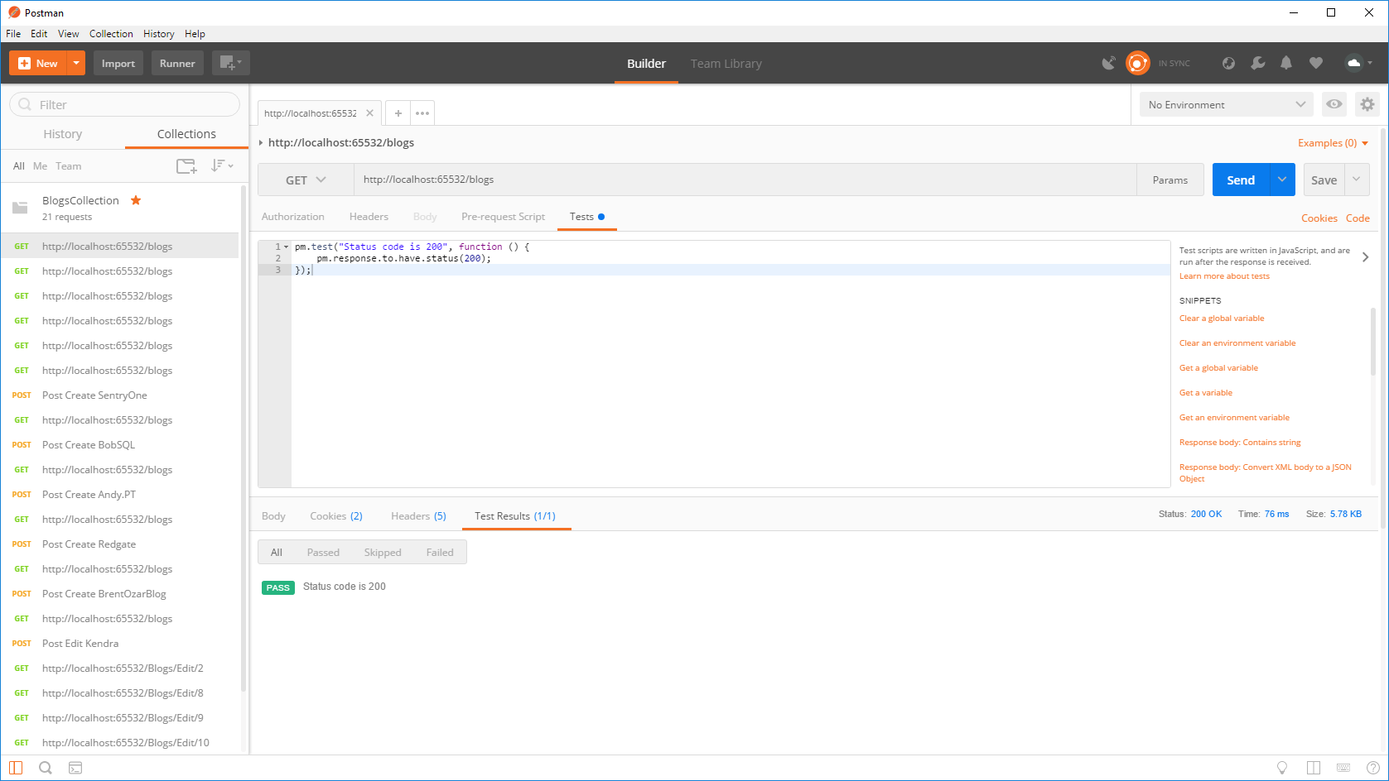

Slide 48


Slide 49


Slide 50


Slide 51


Slide 52




Slide 53


Slide 54
Notes:
Ref: https://docs.microsoft.com/en-us/sql/database-engine/configure-windows/enable-encrypted-connections-to-the-database-engine
Note:
To use encryption with a failover cluster, you must install the server certificate with the fully qualified DNS name of the virtual server on all nodes in the failover cluster. For example, if you have a two-node cluster, with nodes named test1.<your company>.com and test2.<your company>.com, and you have a virtual server named virtsql, you need to install a certificate for virtsql.<your company>.com on both nodes. You can set the value of the ForceEncryptionoption to Yes.

Slide 55


Slide 56


Slide 57
Notes:
Ref: C:\Users\hfleitas\OneDrive\Presentations\Encryption and DB Source Control\Postman\Comparison.xlsx

Slide 58
Notes:
*4 data points out of 600 skewed results due to other processes running on the machine.
Avg was 44.62ms
Removed outliers Avg is 43.71ms
Ref: C:\Users\hfleitas\OneDrive\Presentations\Encryption and DB Source Control\Postman\Comparison.xlsx

Slide 59
DEMO 3
Dynamic Data Masking

Slide 60

Hack DDM

Slide 61


Slide 62


Slide 63


Slide 64


Slide 65


Slide 66


Slide 67
DEMO 4
Row-Level Security

Slide 68

Hack RLS

Slide 70


Slide 71


Slide 72


Slide 73


Slide 74


Slide 75


Slide 76


Slide 77


Slide 78


Slide 79


Slide 80


Slide 81


Slide 82

Notes:
https://1drv.ms/v/s!Aq04euwkcR1Gri1eHpuMq90INzqP
See minute 47.

Slide 83


Slide 84


Slide 86
DEMO 5
Version & Source Control

Slide 87

DB Source Control

Slide 88

Notes:
TFS/SVN Database code project
VS, Create proj, import db, tfs commit, make changes outside, schema compare (update), commit.

Slide 89


Notes:
TFS/SVN Database code project
VS, Create proj, import db, tfs commit, make changes outside, schema compare (update), commit.

Slide 90

Notes:
TFS/SVN Database code project
VS, Create proj, import db, tfs commit, make changes outside, schema compare (update), commit.

Slide 91



Notes:
TFS/SVN Database code project
VS, Create proj, import db, tfs commit, make changes outside, schema compare (update), commit.

Slide 92

Notes:
TFS/SVN Database code project
VS, Create proj, import db, tfs commit, make changes outside, schema compare (update), commit.

Slide 93


Notes:
TFS/SVN Database code project
VS, Create proj, import db, tfs commit, make changes outside, schema compare (update), commit.

Slide 94

Notes:
TFS/SVN Database code project
VS, Create proj, import db, tfs commit, make changes outside, schema compare (update), commit.

Slide 95
TFS
Section

Slide 96





Slide 97

Notes:
TFS/SVN Database code project
VS, Create proj, import db, tfs commit, make changes outside, schema compare (update), commit.

Slide 98


Notes:
TFS/SVN Database code project
VS, Create proj, import db, tfs commit, make changes outside, schema compare (update), commit.

Slide 99

Notes:
TFS/SVN Database code project
VS, Create proj, import db, tfs commit, make changes outside, schema compare (update), commit.

Slide 100

Notes:
TFS/SVN Database code project
VS, Create proj, import db, tfs commit, make changes outside, schema compare (update), commit.

Slide 101

Notes:
TFS/SVN Database code project
VS, Create proj, import db, tfs commit, make changes outside, schema compare (update), commit.

Slide 102

Notes:
TFS/SVN Database code project
VS, Create proj, import db, tfs commit, make changes outside, schema compare (update), commit.

Slide 103

Notes:
TFS/SVN Database code project
VS, Create proj, import db, tfs commit, make changes outside, schema compare (update), commit.

Slide 104

Notes:
TFS/SVN Database code project
VS, Create proj, import db, tfs commit, make changes outside, schema compare (update), commit.

Slide 105



Notes:
TFS/SVN Database code project
VS, Create proj, import db, tfs commit, make changes outside, schema compare (update), commit.

Slide 106



Notes:
TFS/SVN Database code project
VS, Create proj, import db, tfs commit, make changes outside, schema compare (update), commit.

Slide 107

Notes:
TFS/SVN Database code project
VS, Create proj, import db, tfs commit, make changes outside, schema compare (update), commit.

Slide 108

Notes:
TFS/SVN Database code project
VS, Create proj, import db, tfs commit, make changes outside, schema compare (update), commit.

Slide 109

Notes:
TFS/SVN Database code project
VS, Create proj, import db, tfs commit, make changes outside, schema compare (update), commit.

Slide 110

Notes:
TFS/SVN Database code project
VS, Create proj, import db, tfs commit, make changes outside, schema compare (update), commit.

Slide 111

Notes:
TFS/SVN Database code project
VS, Create proj, import db, tfs commit, make changes outside, schema compare (update), commit.

Slide 112

Notes:
TFS/SVN Database code project
VS, Create proj, import db, tfs commit, make changes outside, schema compare (update), commit.

Slide 113

Notes:
TFS/SVN Database code project
VS, Create proj, import db, tfs commit, make changes outside, schema compare (update), commit.

Slide 114

Notes:
TFS/SVN Database code project
VS, Create proj, import db, tfs commit, make changes outside, schema compare (update), commit.

Slide 115

Notes:
TFS/SVN Database code project
VS, Create proj, import db, tfs commit, make changes outside, schema compare (update), commit.

Slide 116

Notes:
TFS/SVN Database code project
VS, Create proj, import db, tfs commit, make changes outside, schema compare (update), commit.

Slide 117

Notes:
TFS/SVN Database code project
VS, Create proj, import db, tfs commit, make changes outside, schema compare (update), commit.

Slide 118


Notes:
TFS/SVN Database code project
VS, Create proj, import db, tfs commit, make changes outside, schema compare (update), commit.

Slide 119

Notes:
TFS/SVN Database code project
VS, Create proj, import db, tfs commit, make changes outside, schema compare (update), commit.

Slide 120

Notes:
TFS/SVN Database code project
VS, Create proj, import db, tfs commit, make changes outside, schema compare (update), commit.

Slide 121

Notes:
TFS/SVN Database code project
VS, Create proj, import db, tfs commit, make changes outside, schema compare (update), commit.

Slide 122
GitHub
Section

Slide 123
Notes:
TFS/SVN Database code project
VS, Create proj, import db, tfs commit, make changes outside, schema compare (update), commit.

Slide 124

Notes:
TFS/SVN Database code project
VS, Create proj, import db, tfs commit, make changes outside, schema compare (update), commit.

Slide 125

Notes:
TFS/SVN Database code project
VS, Create proj, import db, tfs commit, make changes outside, schema compare (update), commit.

Slide 126

Notes:
TFS/SVN Database code project
VS, Create proj, import db, tfs commit, make changes outside, schema compare (update), commit.

Slide 127

Notes:
TFS/SVN Database code project
VS, Create proj, import db, tfs commit, make changes outside, schema compare (update), commit.

Slide 128

Notes:
TFS/SVN Database code project
VS, Create proj, import db, tfs commit, make changes outside, schema compare (update), commit.

Slide 129

Notes:
TFS/SVN Database code project
VS, Create proj, import db, tfs commit, make changes outside, schema compare (update), commit.

Slide 130

Notes:
TFS/SVN Database code project
VS, Create proj, import db, tfs commit, make changes outside, schema compare (update), commit.

Slide 131

Notes:
TFS/SVN Database code project
VS, Create proj, import db, tfs commit, make changes outside, schema compare (update), commit.

Slide 132

Notes:
TFS/SVN Database code project
VS, Create proj, import db, tfs commit, make changes outside, schema compare (update), commit.

Slide 133

Notes:
TFS/SVN Database code project
VS, Create proj, import db, tfs commit, make changes outside, schema compare (update), commit.

Slide 134

Notes:
TFS/SVN Database code project
VS, Create proj, import db, tfs commit, make changes outside, schema compare (update), commit.

Slide 135

Notes:
TFS/SVN Database code project
VS, Create proj, import db, tfs commit, make changes outside, schema compare (update), commit.

Slide 136

Notes:
TFS/SVN Database code project
VS, Create proj, import db, tfs commit, make changes outside, schema compare (update), commit.

Slide 137

Notes:
TFS/SVN Database code project
VS, Create proj, import db, tfs commit, make changes outside, schema compare (update), commit.

Slide 138

Notes:
TFS/SVN Database code project
VS, Create proj, import db, tfs commit, make changes outside, schema compare (update), commit.

Slide 139
Notes:
TFS/SVN Database code project
VS, Create proj, import db, tfs commit, make changes outside, schema compare (update), commit.

Slide 140
DEMO 6
Machine Learning & AI

Slide 141

SQL ML / AI

Slide 142


Notes:
https://netflix.com/trollhunters

Slide 143


Slide 144



Slide 145

Not in 2019ctp2

Slide 146



2017
2019ctp2

Slide 147


Slide 148


2017
2019ctp2

Slide 149

2019ctp2

Slide 150

2017

Slide 151

2019ctp2

Slide 152


Slide 153


Slide 154



Slide 155


Slide 156


Slide 157



Slide 158


Slide 159


Slide 160


Slide 161


Slide 162


Slide 163


Slide 164



Slide 165


Slide 166


Slide 167



Slide 168


Slide 169



Slide 170


Slide 171


Slide 172


Slide 173


Slide 176


Slide 177


Slide 178
Summary
Hack Tabular Data Stream (TDS) (Enable Force Encryption)
Load Test Encryption (Postman)
Hack Dynamic Data Masking (DDM) (Deny Create)
Hack Row-Level Security (RLS) (Amulet of Daylight)
DB Source Control (TFS/Git) (Import, Schema Compare)
Machine Learning & AI (sp_rxPredict wins!, Cognitive API)
Resources

Slide 179

Resources
dba2o.wordpress.com
andy.pt
SQL Server R Services Samples: Microsoft Repo
Pre-Trained ML Models: Install in SQL Server
SQL Server Machine Learning Services: Tutorials
SQL Server Components to Support Python: Interaction of Components
Threading ML: Logistic Regression
Interactive deep learning: Learn alert
ailab.microsoft.com
aka.ms/sqlworkshops
aka.ms/ss19
github.com/hfleitas/Pixies
Notes:
Image ref: https://talesofarcadia.fandom.com/wiki/Jim_Lake_Jr.

Slide 180

Sponsor
1110 W Commercial Blvd, Fort Lauderdale, FL 33309 // Ph. (800) 425-9113 // universalproperty.com
Notes:
https://universalinsuranceholdings.com/career-details/

Slide 181
Session evaluations
This is the link:
bit.ly/pixies19
Your feedback is very important.
Submit your feedback by the end of this presentation.

Slide 182
Hiram Fleitas
Owner Fleitas Arts
@hiramfleitas
Thank You
hiram@fleitasarts.com
fleitasarts.com
/hfleitas
hiramfleitas

